Slide 1
AWS Control Tower

Slide 2
Introduction
What is AWS Control Tower?
Landing Zones
Account Factory
Guardrails
Dashboard

Slide 3
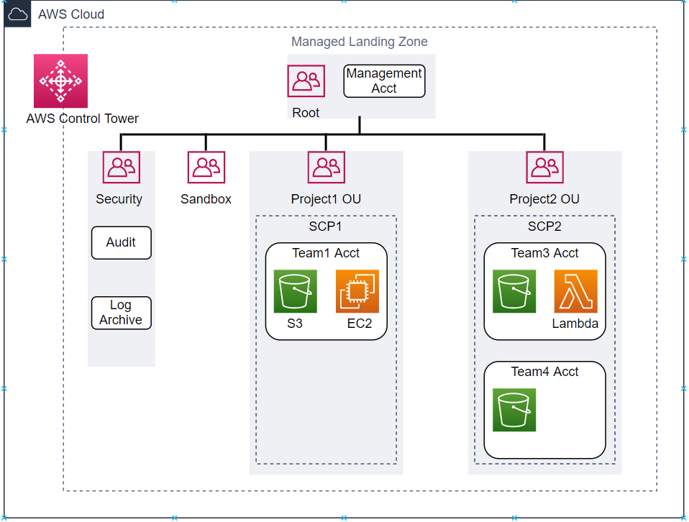
What is AWS Control Tower?
Set up and govern a secure, multi-account AWS environment, called a landing zone.
It creates a landing zone using AWS Organisations, bringing ongoing account management and governance as well as implementation best practices.
Automate the setup of your multi-account AWS environment with just a few clicks.
Notes:
AWS Org contains your AWS Accounts
An AWS account is a container for your resources.
It also empowers your teams by providing them designated accounts, and you can automatically provision resources and permissions
You can use Organizations to apply policies that give your teams the freedom to build with the resources they need, while staying within the safe boundaries you set.
By organizing accounts into organizational units (OUs)

Slide 4
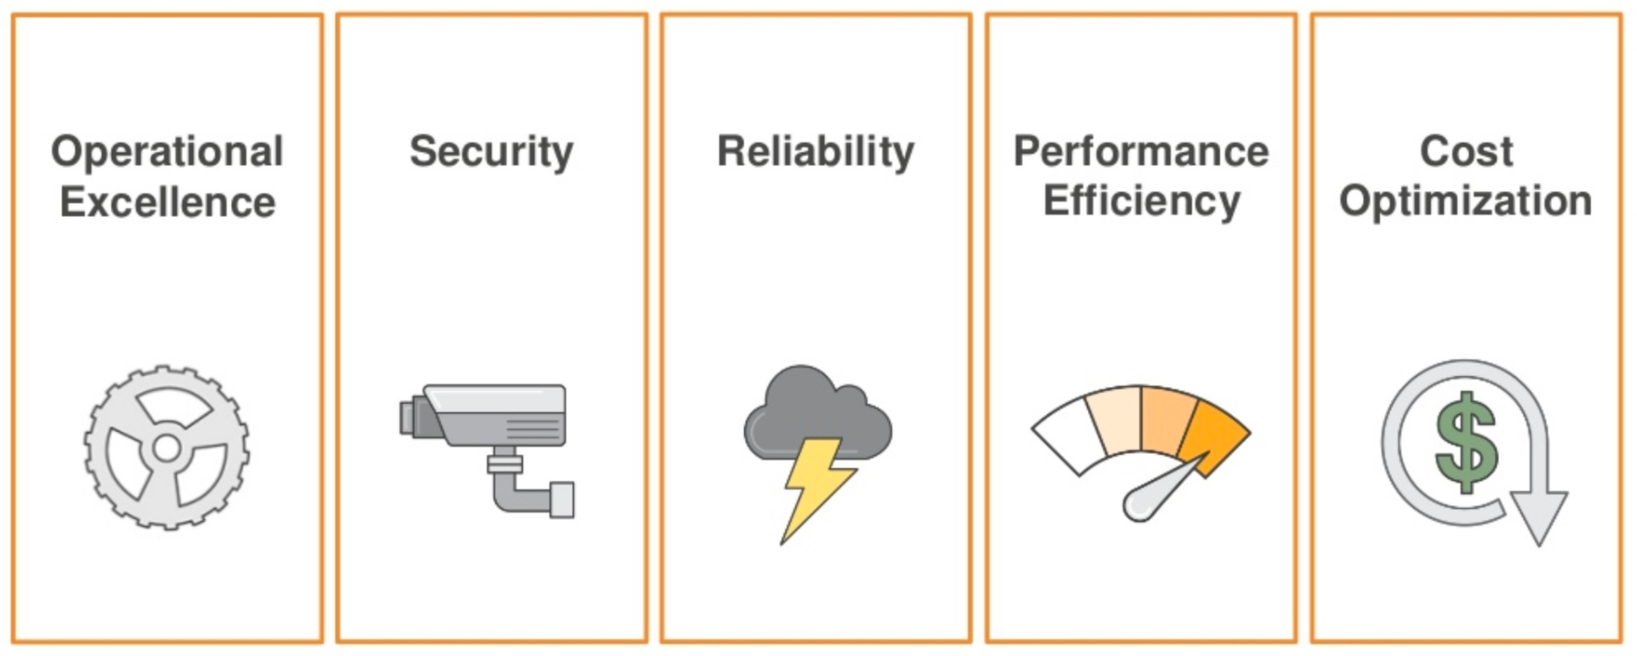
Landing Zones
A landing zone is a well-architected, multi-account AWS environment based on security and compliance best practices.
Landing zones offer an effective way to simplify and de-risk cloud adoption. They give developers a pre-configured foundation to build on in the vast ecosystem of the cloud.
Read more on the AWS well-architected framework here.
The landing zone set up by AWS Control Tower is managed using a set of mandatory and strongly recommended guardrails, which you select through a self-service console to ensure that accounts and configurations comply with your policies.

Slide 5
Account Factory
The account factory automates provisioning of new accounts in your organization.
An AWS account is a container for your resources. Using multiple accounts gives you built-in security boundaries.
As a configurable account template, it helps you standardise provisioning of new accounts with pre-approved account configurations.

Slide 6
Guardrails
Preventive and detective
Mandatory and optional
AWS Control Tower offers a curated set of guardrails based on AWS best practices and common customer policies for governance.
Guardrails are pre-packaged governance rules for security, operations, and compliance.
Preventive guardrails establish intent and prevent deployment of resources that don’t conform to your policies
Detective guardrails (for example, ‘Detect whether public read access to Amazon S3 buckets is allowed’) continuously monitor deployed resources for nonconformance.
Mandatory Guardrail example: Disallow cross-Region networking
Optional Guardrail example: Detect whether MFA for the root user is enabled

Slide 7
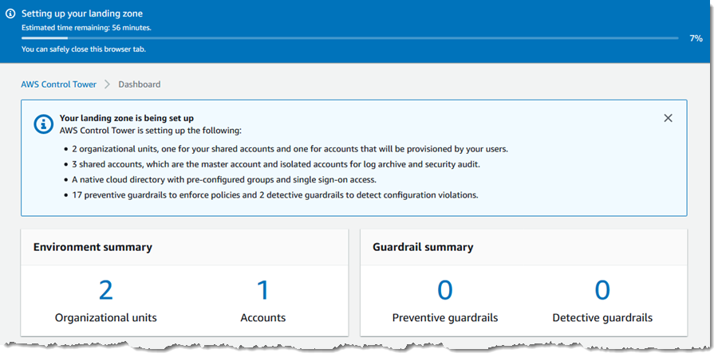
Dashboard
The AWS Control Tower dashboard gives you continuous visibility into your AWS environment.
DEMO!

